Slide 1
Making best out of the Data
Leveraging Analytics for Technical Efficiency and Enhanced User Experience
Renisha Fernandes
Staff Engineer, VMware
Muskan Prajapati
Member of Technical Staff, VMware
14th June 2023

Slide 2
SRE @ VMC
Overview of Automation Platform and scale
Scale of Automation Platform
Analytics driven services in Automation Platform
    1 Outage management
    2 Script execution
    3 Scan and patch
    4 User experience enhancement
    5 Slackbot
Challenges
Take Away

Slide 3
SRE @ VMC

Slide 4
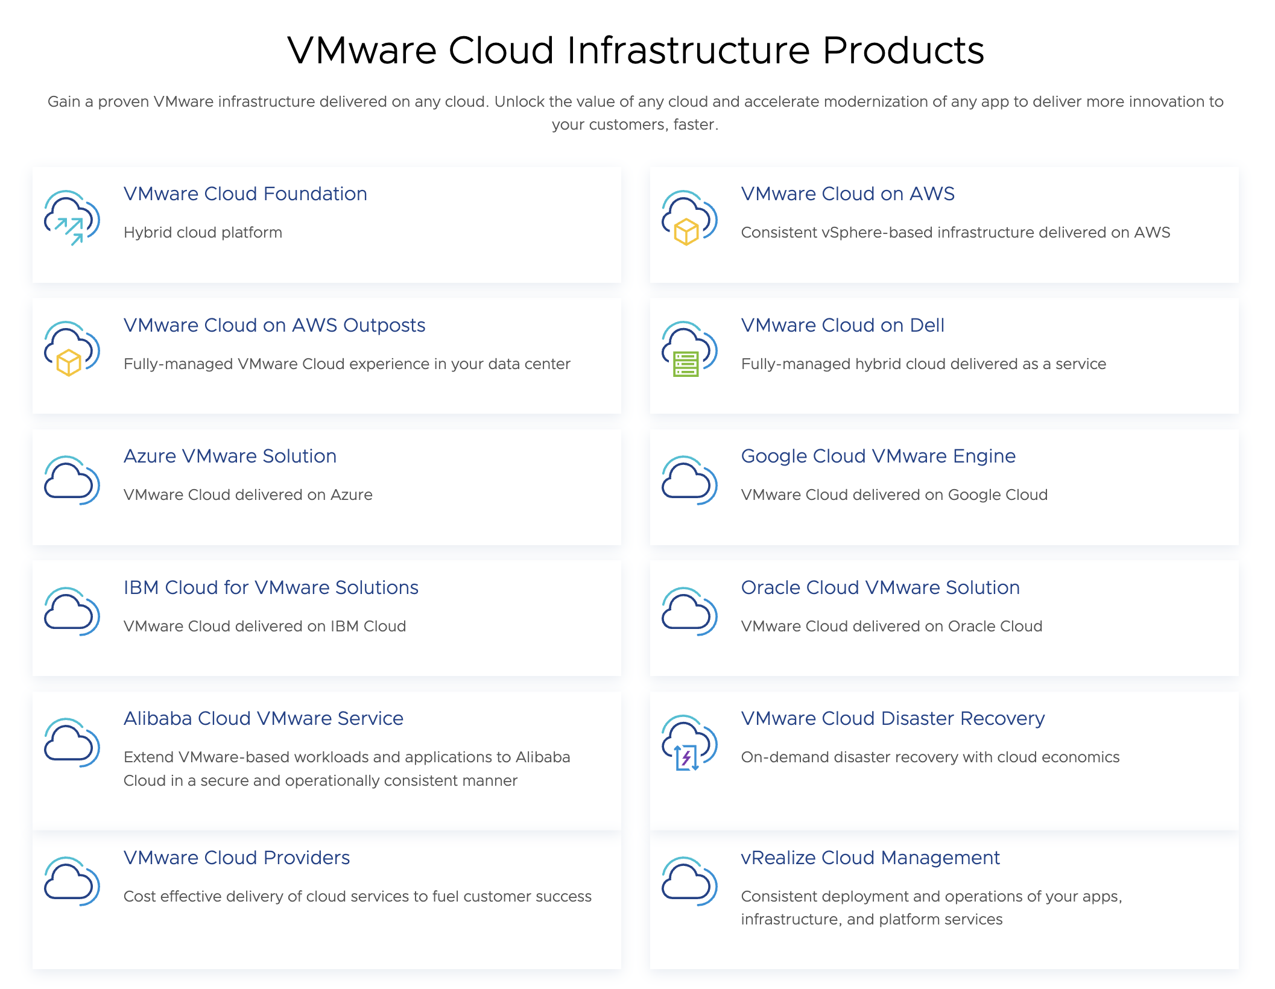

Slide 5
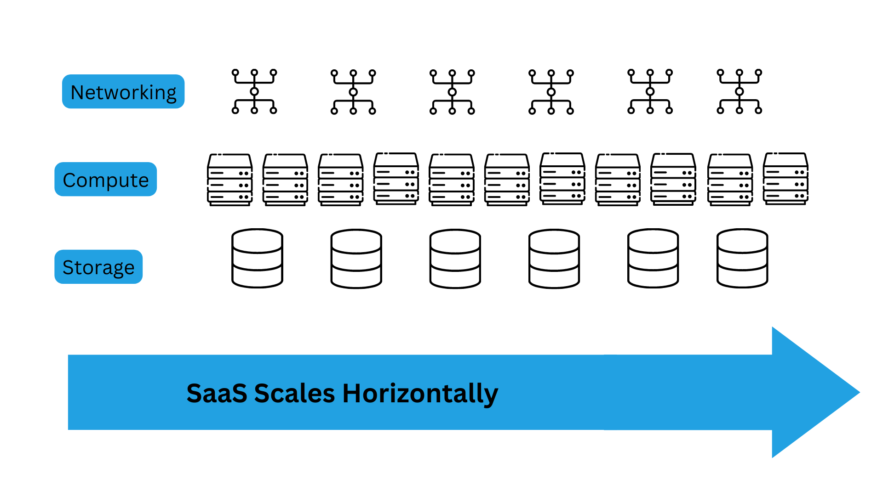
SaaS vs Individual Multi Environment Infrastructure at Scale
SRE is focused on ensuring services are homogeneous as they scale
Complexity and variability increase risk to the SLAs

Slide 6

VSAP Solutions
Automation agility - Toil reduction through automation of common tasks
Incident Management automation - Temporary remediation of known issues through automation, to bridge to the next M/V release bundle
Unified operational view- External data gathering without needing direct access to production
Automation tooling convergence – Any script Any platform
Operator Access – Persona Single Sign On with controlled access to operate provider env
Notes:
What all feature or solutions we provide :
Automation agility - Toil reduction through automation of common tasks
Incident Management automation - Temporary remediation of known issues through automation, to bridge to the next M/V release bundle
Unified operational view- External data gathering without needing direct access to production
Automation tooling convergence – Any script Any platform
Operator Access – Persona Single Sign On with controlled access to operate provider env

Slide 7
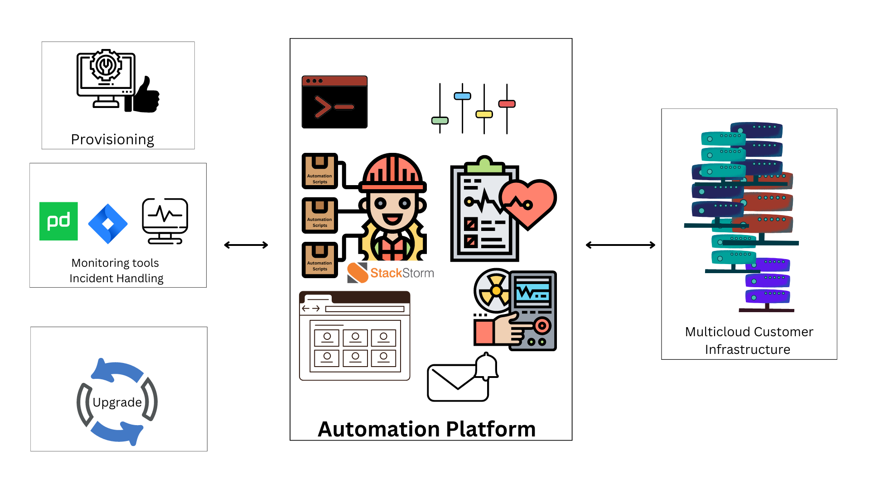
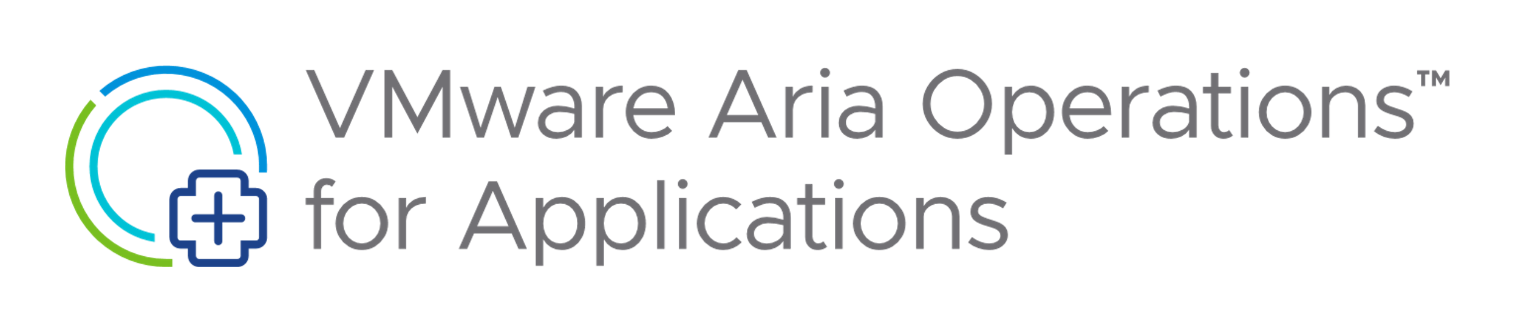
Overview of Automation Platform
Notes:
Focusing on tool monitoring and incident handling here.

Slide 8
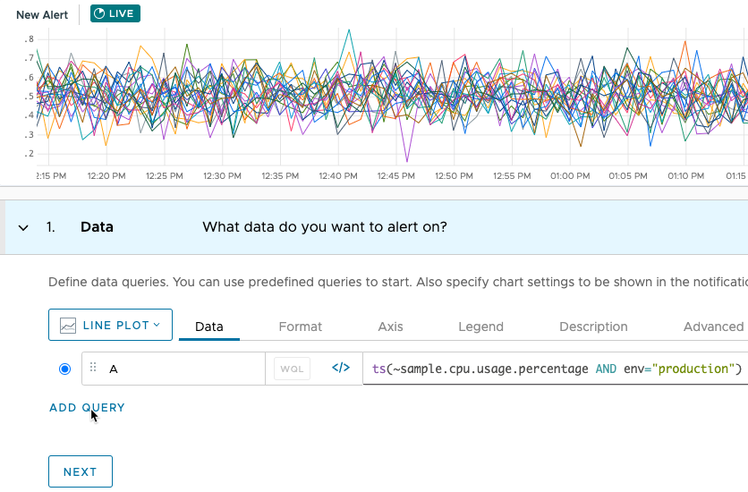

Slide 9

OMS : Outage management service
WaveFront Alerts and Incidents
Correlation
Outage Detection
Auto-Triaging and Auto-Remediation
Stakeholder engagement
Notes:
1. I hope till now you all are following us that we have our automation platform performing automations which works hand in hand with Wavefront alert generation and incident creation
2. One of the major incidents that can cause significant breach in MTTR and SLA is an Outage.
Be it a rack outage or an AZ wide outage, this kind of incidents can consume a lot of time in manual triaging and remediations.
3. This is where we felt need to build this amazing service called OMS : Outage management service
4. OMS is an ML based system which is trained on past incident data. So when an actual outage occurs it can correlate the incidents and detect this outage.
5. One of the best feature of OMS is that it perform the Auto triaging and gives us all the details of the impact radius or the bird eye view of what is happening.
6. Not only that it automatically starts remediating the impacted services by running the health check probes and other relevant remediations.
7. It also engages the stakeholders as part of the process of having a reduced MTTR.

Slide 10

Analytics for Scan and patch
Scan and detect Inconsistent CI drifts
Patch proactively
Telemetry data collection : Drift impact radius
Enforce Configuration Standards
Notes:
1)Scan and patch is a service which scans for drifts (caused by inconsistent configuration items (CIs) across services) and patches these
2)With sens and react system, drifts are easy to locate and patch.
3)By using telemetry data of scan and patch service we identify when and where are these drifts occuring like fleet or SDDC specific.
4)With this we can take proactive measures to mitigate it.
6) we can enforce certain configuration standards.

Slide 11
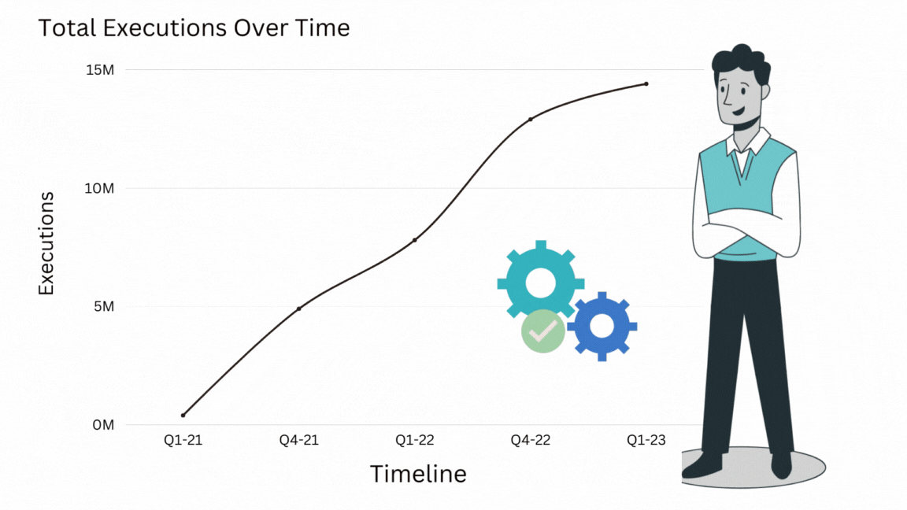
Script Executions analytics
2k+ scripts and 10M+ executions
Script popularity
Success Rate
Script rot and deprecation
Collaboration guidelines
Notes:
1.For automation platform team everything boils down to an automation. That is script execution
2.We have 2k + script and 10 m+ executions, hence its critical to have constant monitoring and improvement in script executions. To have relevant and efficient.
3. We have execution related telemetry this gives deep dive in the script execution usage
If some scripts are used very the most used scripts we understand why its most used, if this is a workaround script, we should fix it. It can be a part of product improvement.
If some scripts are manually executed in a flow n number or times then Is there a possibility to add automated workflow?
4. Success Rate We record success rate to identify and improve scripts with low success rate.
5. Diligently monitor the lifecycle of the script and we deprecate unused script
6.We can also send guidance mail to script new onboarded owners

Slide 12
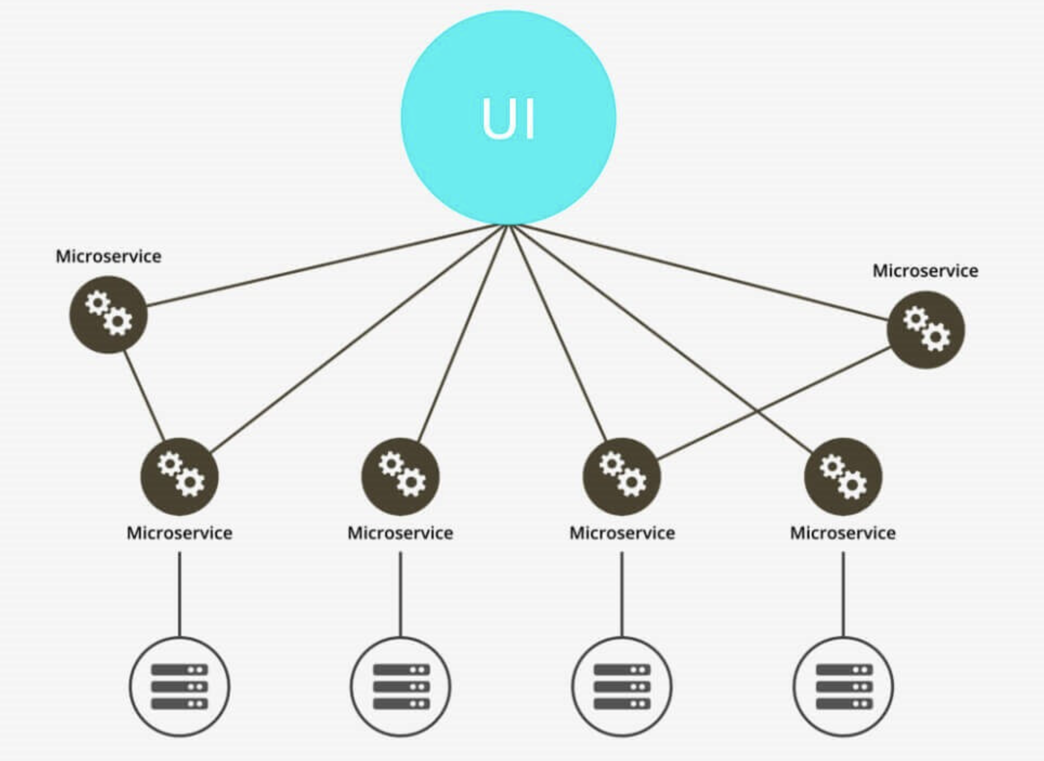
Plethora of microservices managing tons of executions
Notes:
As you can see here we have plathora of microservies which are managing these executions.
And to give a single glass pane view we have a UI.
And since from this UI we project n numbers of customer impacting features, we use analytics for this as well

Slide 13

UI Analytics
Telemetry and event data collection
Insightful report generation
Feature utilization
UX Personalization
Auditability
Notes:
1. We collect the telemetry data of user interaction and event data and generate insightful reports.
2. With this report we get to know the feature usage which tells us about which feature are actually being used and which are not and why.
This helps us prioritize improvement efforts
3. Since we interact with customer infrastructure, then from security and compliance perspective we need to have auditability for user interaction.
4. We have customer from different providers and coming to UI and have more usage of certain set of features so we also have done User Experience personalization,
Which reduces toil.

Slide 14

Slackbot
Slack assist channel
Trained on NLP model
Context aware vector embeddings
Assist channel telemetry
Notes:
1.In last slide I mentioned about many features right, so these features are used by multiple teams and we have huge inflow of queries on our slack assist channel for our on-call engineer.
2. That too after writing thousands of pages of documents
3.So this smart slackbot is here to rescue. Slack bot uses NLP an d has been trained on historical data.
4.The special thing about this slackbot is that it uses CONTEXT aware vector embeddings which can more accurately understand the user’s intentions behind the query and gives accurate suggestions.
5.Additional thing that we do is collect slackbot’s telemetry and use it for Runbook improvements.

Slide 15

Challenges
Data quality – Shit in, Shit out
Data storage
Telemetry is never enough..
Notes:
Although using analytics for SRE operations is extremely helpful, but Unlike Gardens by the bay this garden is not always green, there are some challenges :
1)The critical challenge is the data quality, because Shit-in Shit out. Dodging biased and inconsistent data is important.
2)Another challenge is the data storage and retention period, Having that sweet balance between quality and cost is hard.
3)Telemetry data is like chocolate glazed doughnut, you can never have enough. you would always want more of it to generate more acurate results.

Slide 16
Take Away
Analytics should be a building block of any service that helps SRE.
If you have right data, you can build systems that take almost correct decision for you almost all the time.
It is also important to handle data with care.

Slide 17
Q & A

