Slide 1
sRoute: Treating the Storage Stack Like a Network
Ioan Stefanovici, Bianca Schroeder
Greg O’Shea
Eno Thereska
&
You may re-use these slides freely, but please cite them appropriately:
“sRoute: Treating the Storage Stack Like a Network. Ioan Stefanovici, Bianca Schroeder, Greg O'Shea, Eno Thereska.
In FAST’16, Santa Clara, CA, USA. Feb 22-25,2016.“

Slide 2
The Data Center IO Stack Today
VM
IO stack is statically configured
For example:
Adaptive replication protocol?
Dynamic processing of selected IOs?
Dynamic IO path changes
VM
Application
Application
Data/Cache
Container
Data/Cache
Guest OS
Application
Guest OS
Container
Virus Scanner
Page Cache
Page Cache
KV Store
Data/Cache
OS
File System
File System
Data/Cache
Page Cache
Scheduler
Scheduler
OS
Network FS
Hypervisor
Page Cache
Encryption
Network File System
Network FS
Scheduler
Driver
Scheduler
Storage Server
Storage Server
Cache
Cache
What if we could programmatically
control the path of IOs at runtime?
Deduplication
Deduplication
File System
File System
Scheduler
Scheduler

Slide 3
sRoute: Treating the Storage Stack Like a Network
Programmability + control
Software-Defined Networking (SDN)
Software-Defined Storage
Observation:
IO path changes at the core of much storage functionality
Hypothesis:
Storage functionality via a programmable routing primitive
IO Routing: ability to dynamically control path and destination of Reads/Writes at runtime
Storage Switch
(sSwitch)

Slide 4
E.g. Tail Latency Control
Storage Server
S₁
Storage Server
S₂
IO Routing Challenges:
!!!
Storage traffic is stateful
(in contrast to networks)
Maintain file system semantics
Consistent system-wide configuration updates
Data + metadata consistency
VM₁
VM₂
…
VM_{n}

Slide 5
IO Routing Types
Tail latency control
Copy-on-write
File versioning
Endpoint
p
X
p
Y
:
Specialized processing
Caching guarantees
Deadline policies
p
p
Waypoint
:
X
W
X
r
r
p
p
X
Maximize throughput
Minimize latency
Logging/debugging
Scatter
:
X
Y
r
r
Z
Implement/enhance storage functionality by using a common programmable routing primitive

Slide 6
sRoute Design
Today:

Slide 7
sRoute Design
Specialized stages
Can perform operations on IOs
sRoute:

Slide 8
sRoute Design
Specialized stages
Can perform operations on IOs
sSwitches
Programmable
Forward IOs according to routing rules
sRoute:

Slide 9
sRoute Design
Specialized stages
Can perform operations on IOs
sSwitches
Programmable
Forward IOs according to routing rules
Controller
Global visibility
Configure sSwitches & specialized stages
Installs forwarding rules
End-to-end flow based classification
Extends IOFlow [SOSP’13]
sRoute:

Slide 10
sSwitch Forwarding
File:
Stage C:
Controller:
Routing Rule Matching
<IO Header> → return{Destinations}
Implementation Details
Kernel-level
File granularity IO classification
Forwarding within same server
User-level
Sub-file-range classification + forwarding
Routing Address
File: Remote host + file name
Stage: <device name, driver name, altitude>
Controller
X
S₁
VM₁
Y
S₂
<VM₁,∗, //S₁/X >→ (return < IO, //S₂/Y >)
X
S₁
VM₁
C
<VM₁,∗, //S₁/X >→ (return < IO, //S₂/C >)
X
S₁
VM₁
Controller
<VM₁,W,∗ >→ (return < IOHeader, Controller >)

Slide 11
Control Delegates
IO Routing Rule
IOHeader –> F() ; return{Destinations}
X
Storage Server
S₁
Storage Server
S₂
sSwitch at VM₁:
Control delegate F():
!!!
Insert(<VM₁, W, //S₁/X>, (F(); return <IO, //S₂/X>))
Insert(<VM₁, R, //S₁/X>, (return <IO, //S₁/X>))
R
W
R: 0-512KB
Delete(<VM₁, R, //S₁/X>)
Insert(<VM₁, R, //S₁/X, 0, 512KB>, (return <IO, //S₂/X>))
Insert(<VM₁, R, //S₁/X>, (return <IO, //S₁/X>))
VM₁

Slide 12
Consistent Rule Updates
Per-IO consistency
Per-flow consistency

Slide 13
Per-IO Consistency
IOs flow through old or new rules, but not both
Drain
Quiesce
VM
Stage
Stage
…
sSwitch programmable API
Stage
…
Insert(IOHeader, Delegate)
Delete(IOHeader)
Quiesce(IOHeader, Boolean)
Drain(IOHeader)

Slide 14
Per-Flow Consistency
Maintaining Read-after-Write data consistency
(Reads return the data from the latest Write)
Single source: per-IO consistency
Drain
Quiesce
VM
Stage
Stage
…
Stage
…

Slide 15
Per-Flow Consistency
Read-after-Write consistency
(Reads return the data from the latest Write)
Multiple sources: phases
Drain
Quiesce
VM₁
Stage
…
…
Drain
Stage
Quiesce
VM_{n}
Stage
…

Slide 16
Per-Flow Consistency
Read-after-Write consistency
(Reads return the data from the latest Write)
Multiple sources + control delegates
S₁
S₂
S₁
S₂
2PC
VM₁
VM₂
VM₁
VM₂

Slide 17
Control Application Case Studies
Replica Set Control
Read/Write replica set control
63% throughput increase
File Cache Control
Cache disaggregation, isolation, and customization
57% overall system throughput increase
Tail Latency Control
Fine-grained IO load balancing
2 orders of magnitude latency improvements
Please see paper for more details!
p
p
X
X
Y
r
r
Z
p
p
X
W
X
r
r
p
X
p
Y

Slide 18
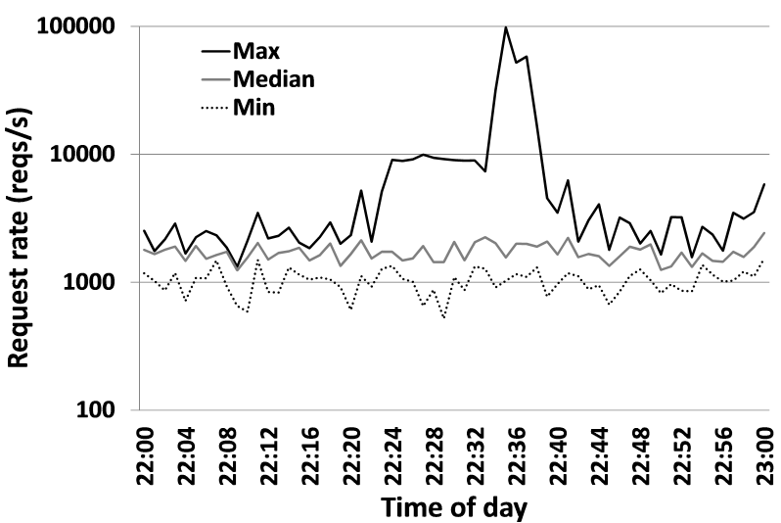
Tail Latency
Storage Server
S_{max}
Storage Server
S_{min}
Exchange servers
Temporarily forward IOs from loaded volumes onto less loaded volumes
Maintain strong consistency
!!!
VM₁
VM₂
…
VM_{n}

Slide 19
Tail Latency Control Application
Each storage server:
Avg_{hour}: exponential moving average – last hour
Avg_{min}: sliding window average – last minute
Temporarily forward IO if:
Avg_{min} > ⍺ Avg_{hour}
S_{max}
S_{min}
sSwitch:
Insert(<*, w, //S_{max}/VHD_{max}>, (F(); return <IO, //S_{min}/T>))
Insert(<*, r, //S_{max}/VHD_{max}>, (return <IO, //S_{max}/VHD_{max}>))
VM_{max}

Slide 20
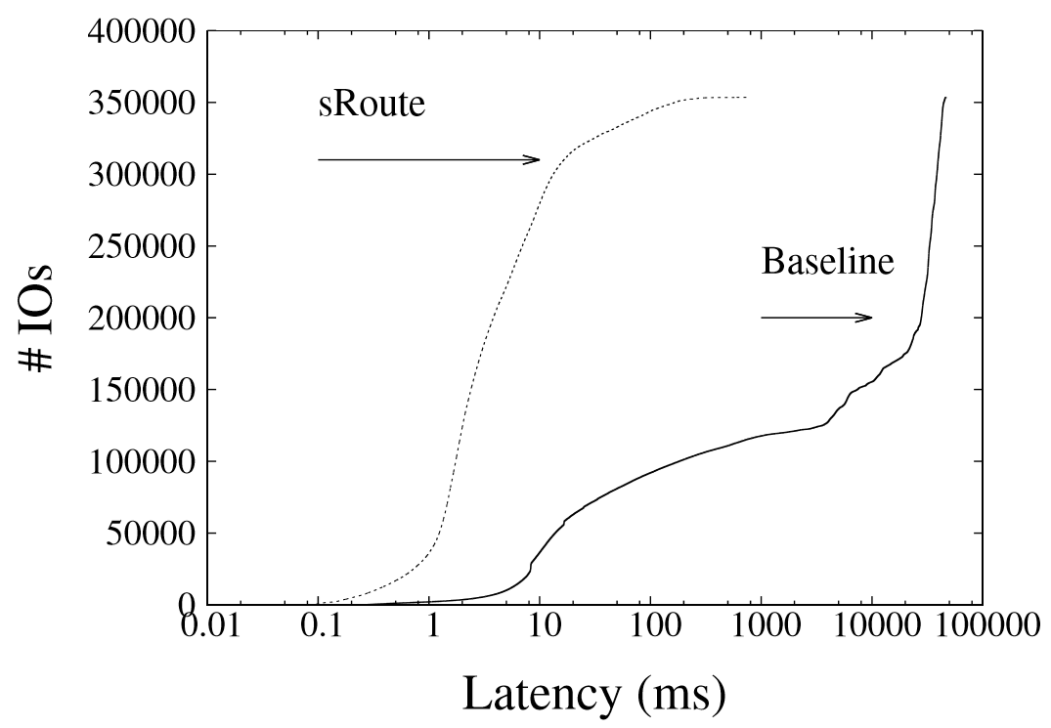
Tail Latency Control Results
Orders of magnitude latency reductions
Max Volume Latency
90%
< 20 miliseconds
50%
> 20 seconds

Slide 21
Conclusion
What if we could programmatically control the path of IOs at runtime?
Hypothesis: storage functionality via a programmable routing primitive
Challenges:
IO statefulness
Data/metadata consistency
Consistent rule updates
Case studies
Replica set control
File cache control
Tail latency control
Please read our paper for more details!

Slide 22
Thank you!
?
Questions?

